Slide 1
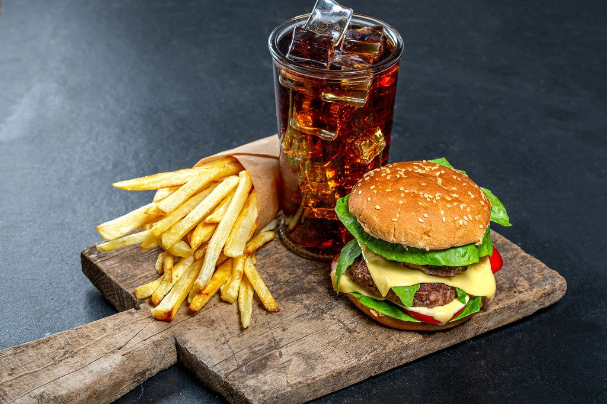
JUNK FOOD
This Photo by Unknown Author is licensed under CC BY

Slide 2
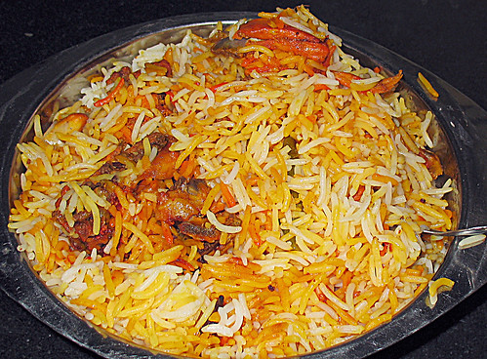
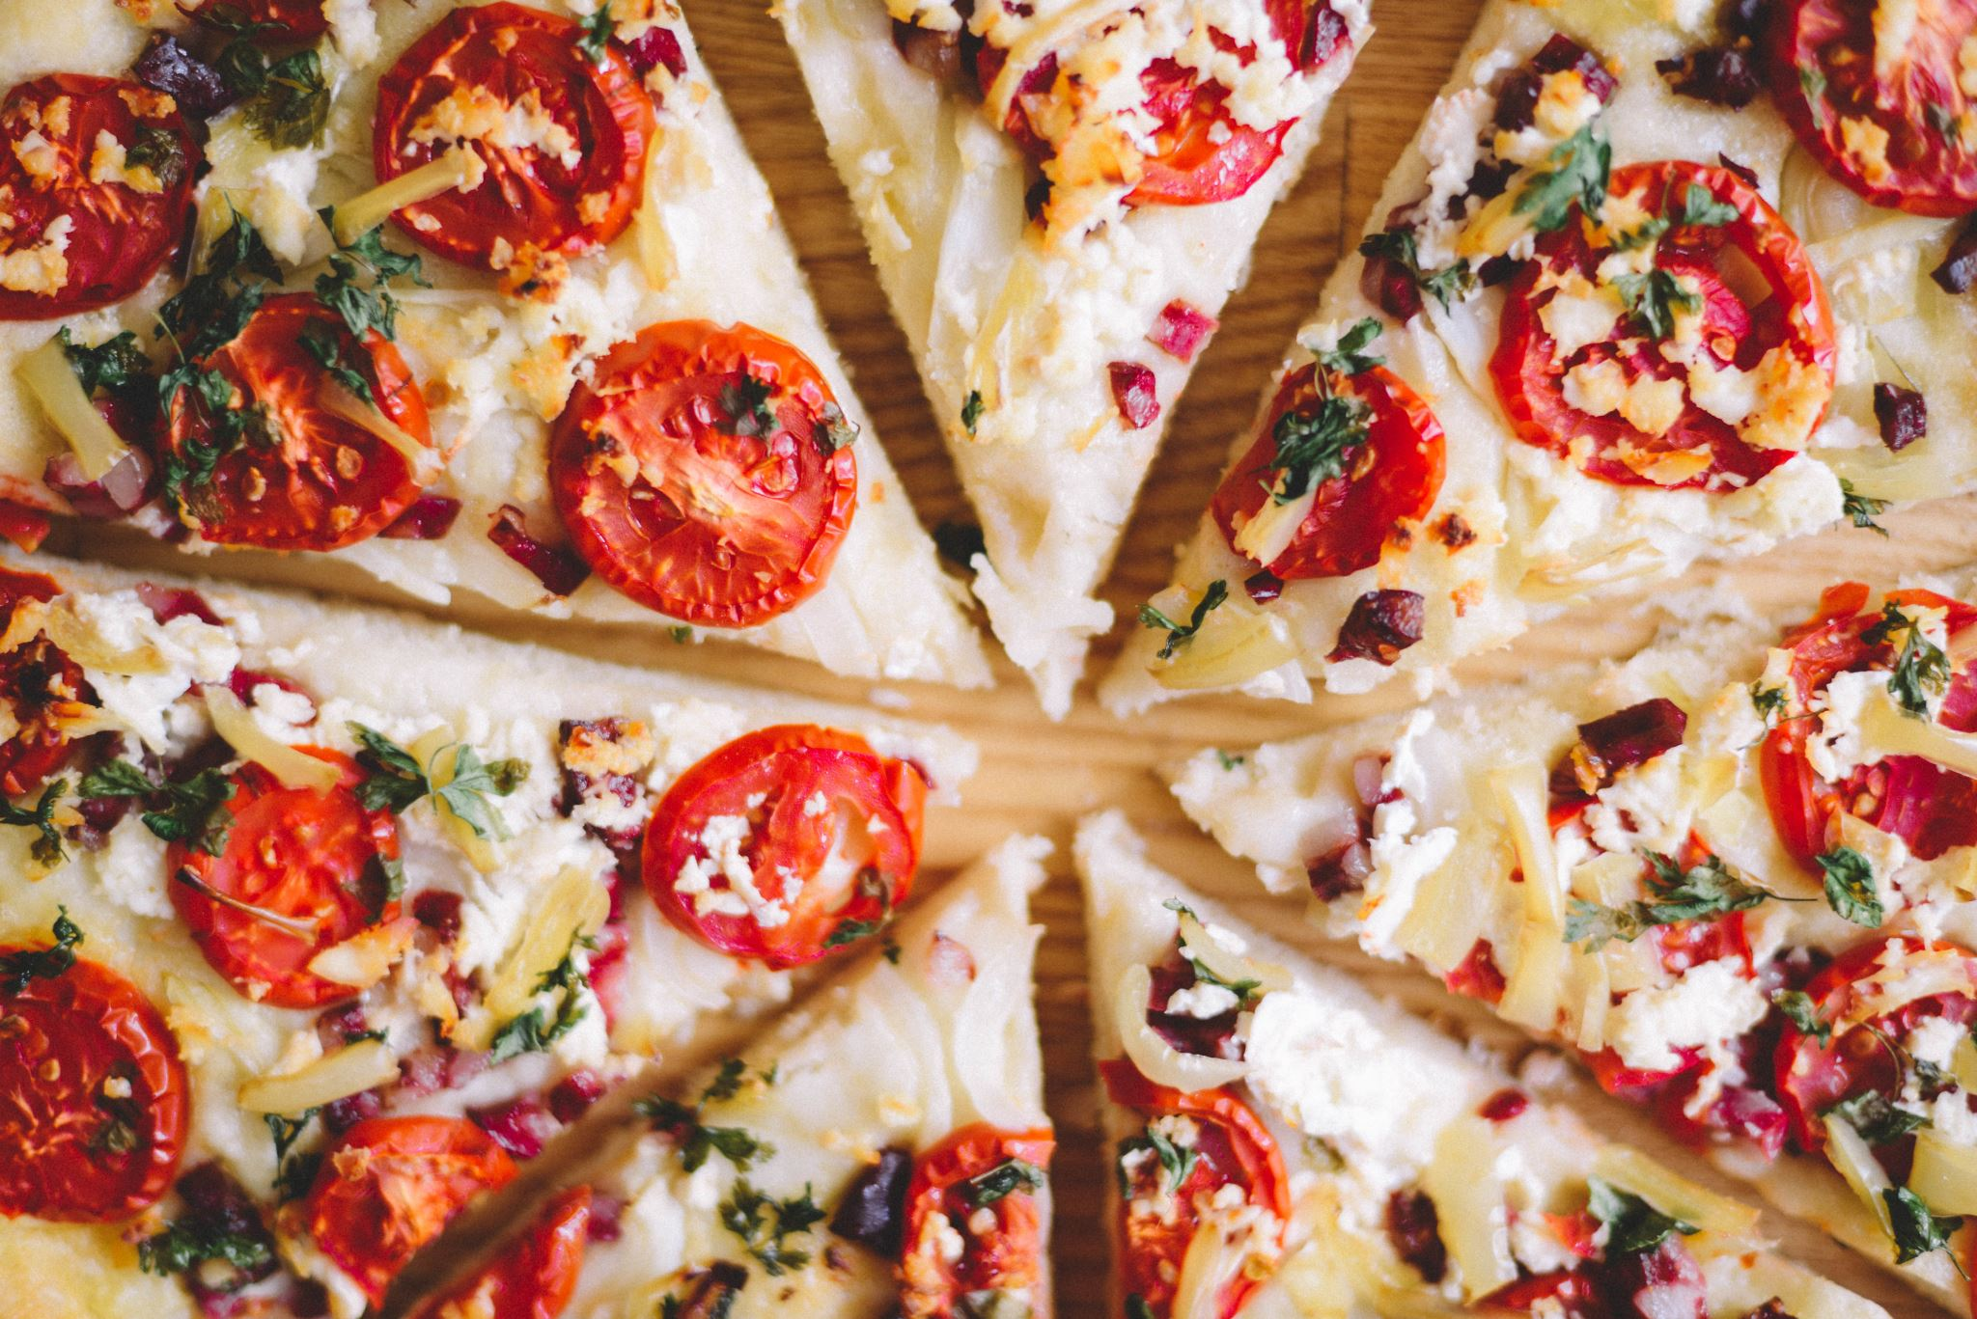
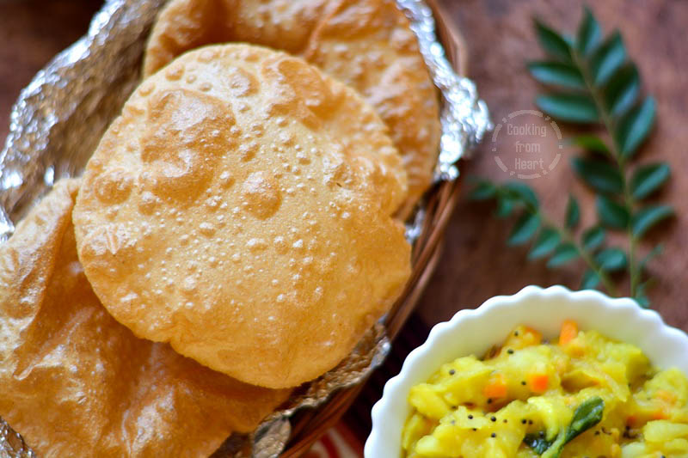
What is it ?
Junk food is a type of food that contains a lot of calories , fats , sugars, and salt and contains few proteins , vitamins and minerals.
This Photo by Unknown Author is licensed under CC BY-NC-ND

Slide 3
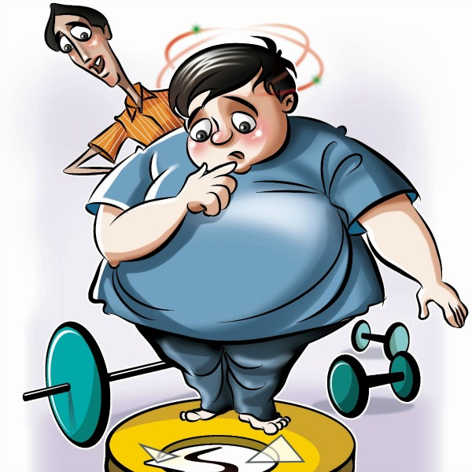
IT IS BAD BECAUSE IT HAS……….
TOO MUCH FAT:-
The junk food contains a lot of fats.
A diet with too much fat can cause obesity or increase of weight causing diseases in many parts of the body including heart.

Slide 4
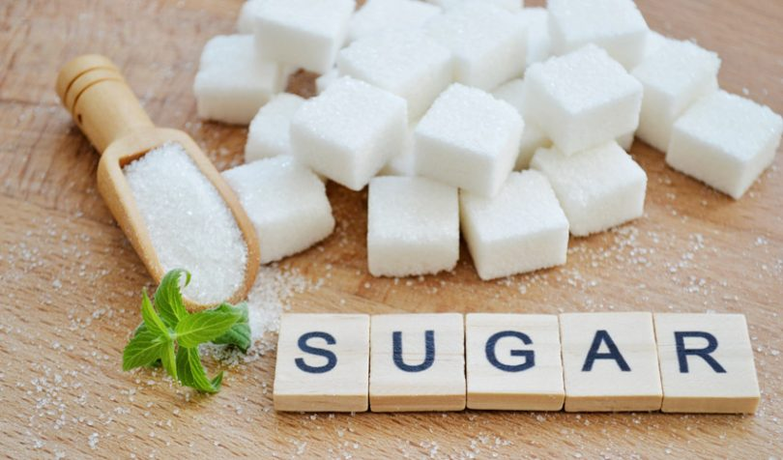
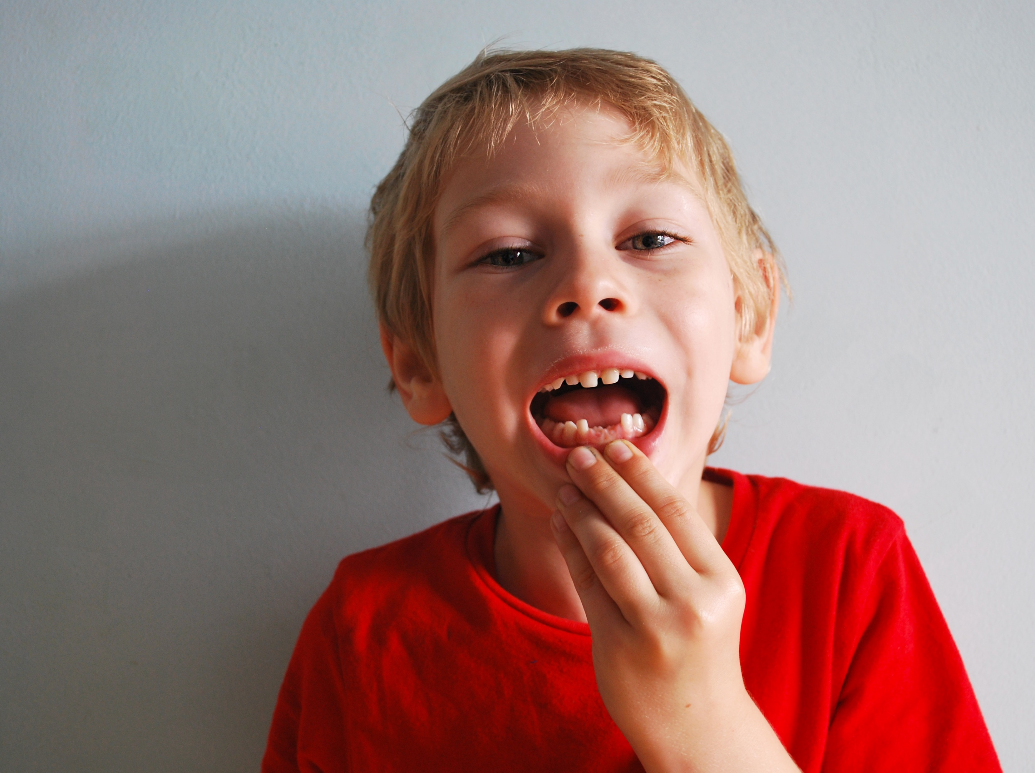
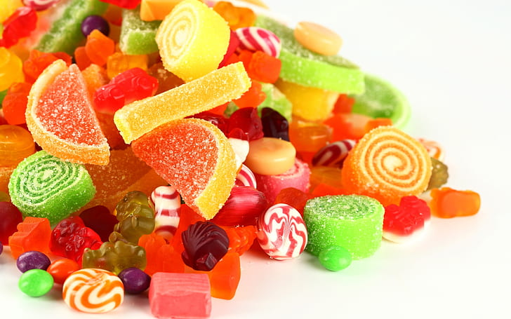
TOO MUCH SUGAR :-
This food contains great quantities of sugar which makes it delicious but too much sugar creates fat , decays our teeth and it is bad for our blood.

Slide 5
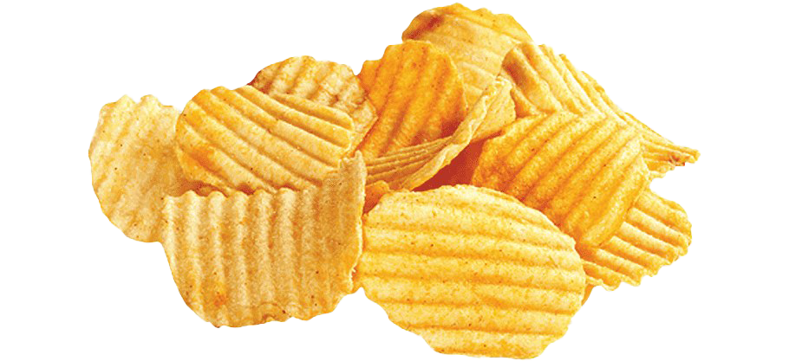

TOO MUCH SALT:-
Usually junk food contains a lot of salt which contains sodium in it and sodium in high quantities is bad for our body.

Slide 6
Why Do We Prefer Junk Food:
it is everywhere
quick and easy
it is cheap
it tastes good and very attractive

Slide 7
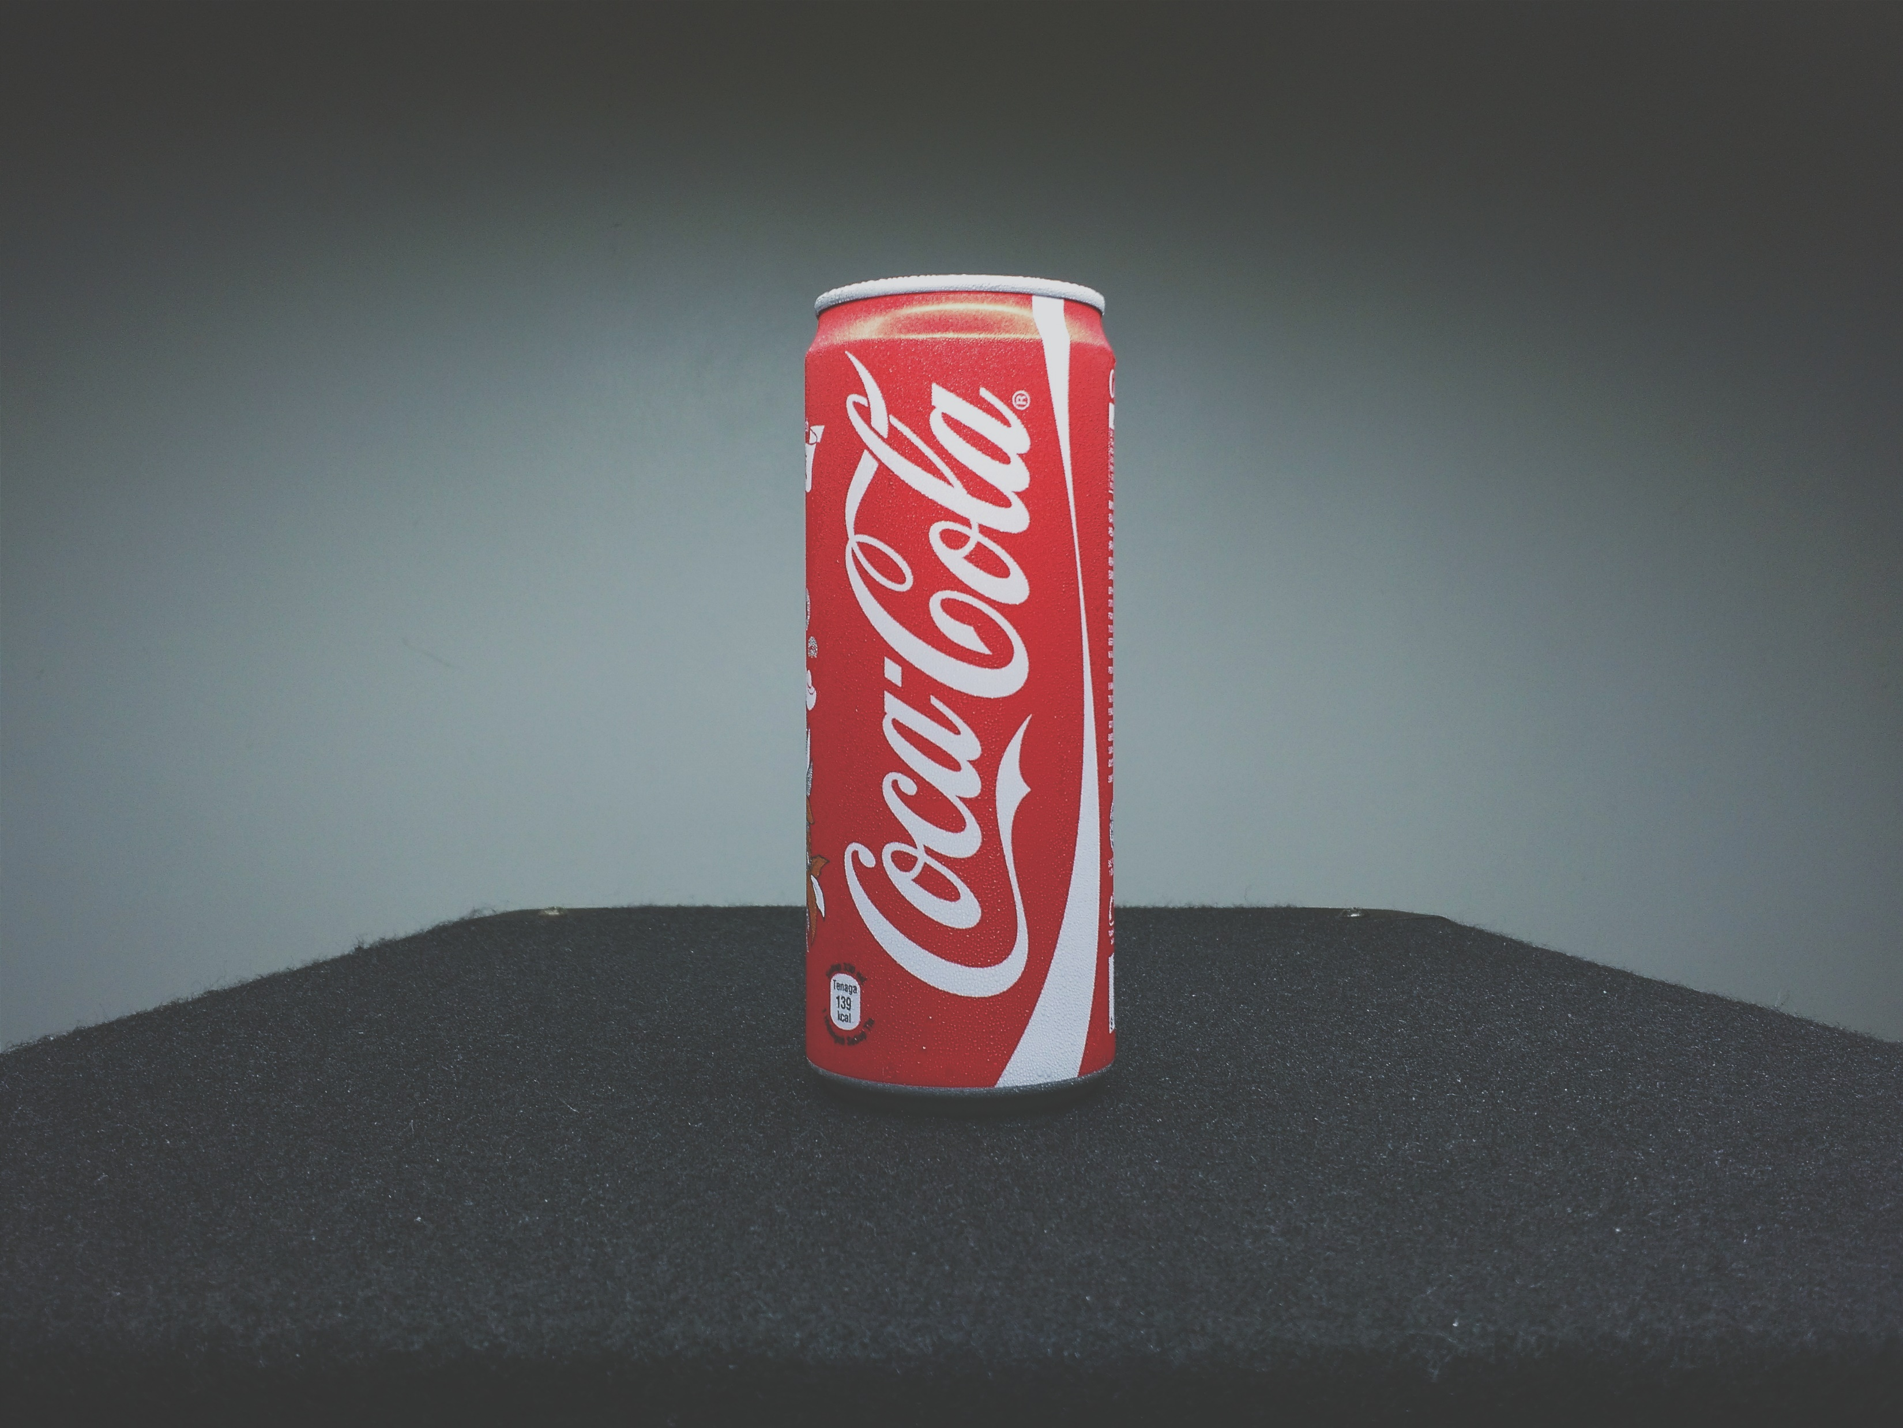
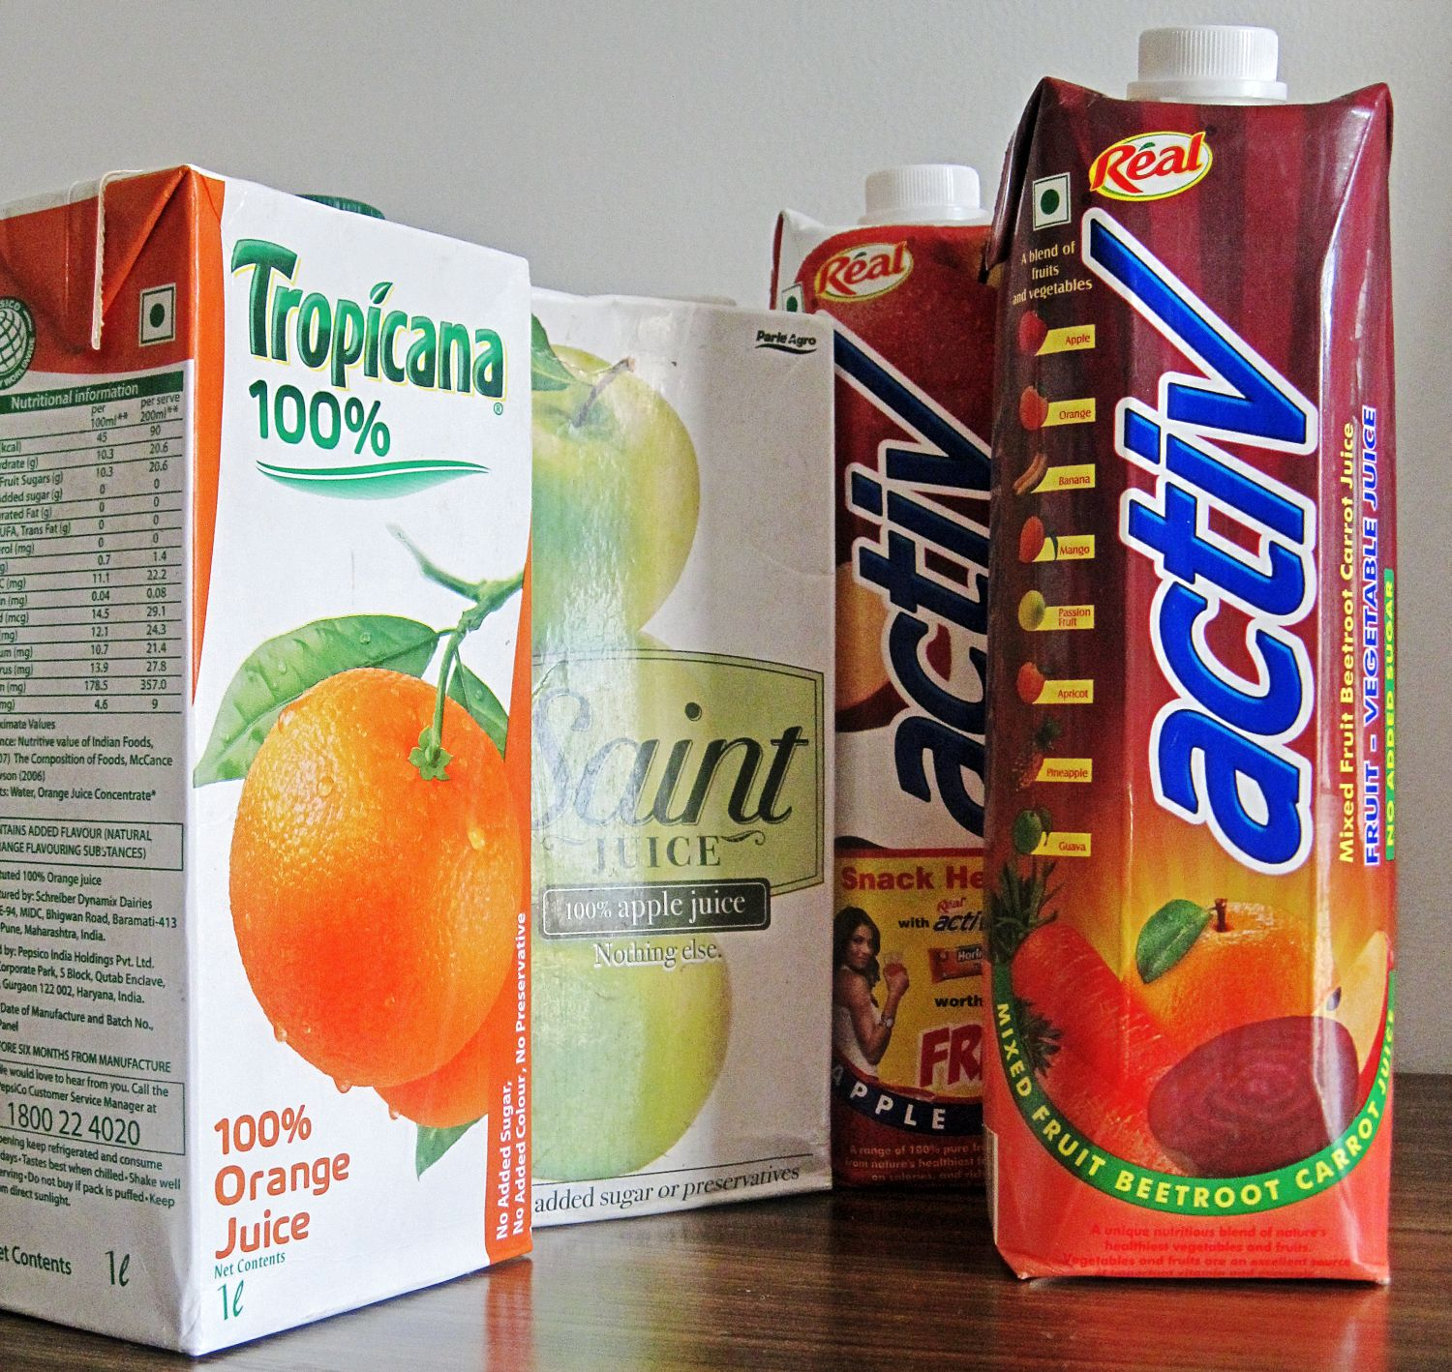
ITS EFFECTS: ~packaging ~fast food places use a lot of packaging. ~the overuse of straws, boxes and plasticware is the biggest source of urban litter.
This Photo by Unknown Author is licensed under CC BY

Slide 8


JUNK FOOD CAUSES FATIGUE:
Eating junk food gives a feeling of fullness in the stomach. The child may become tired and is also not able to perform the daily tasks.

Slide 9
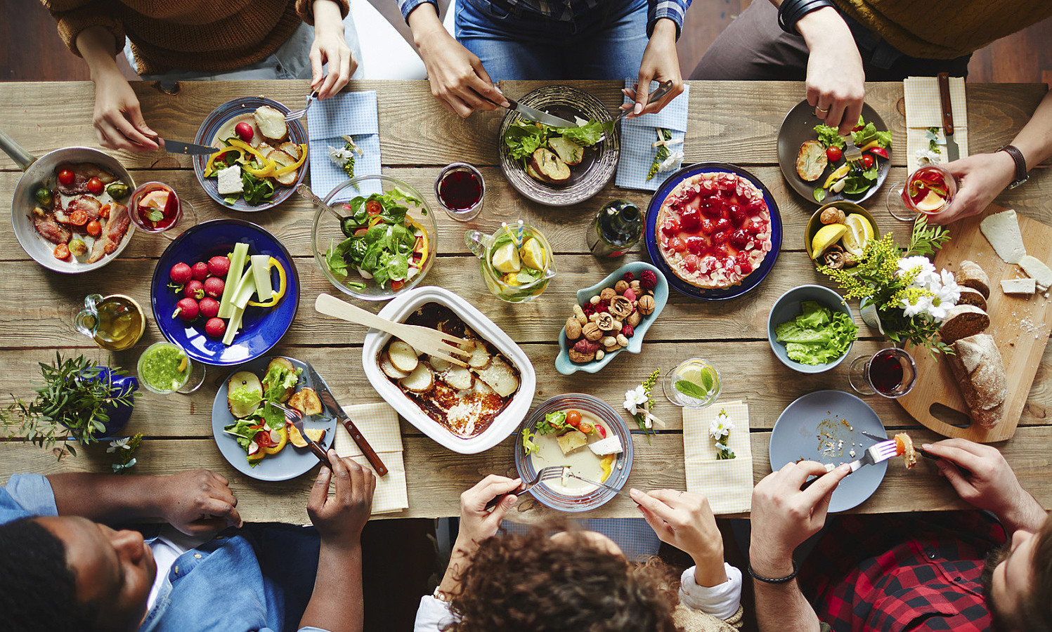
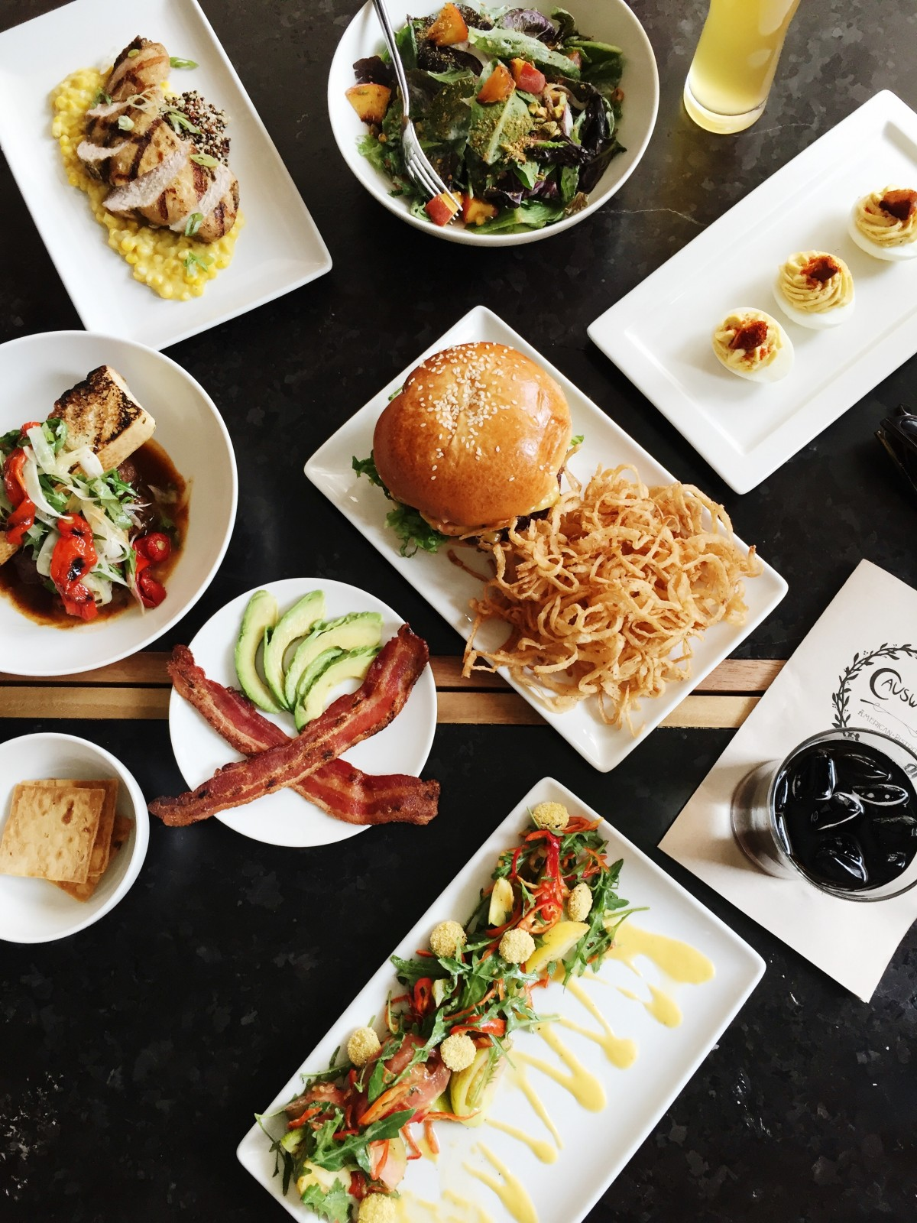
FAMILY TIME DECRESE:
By eating too much one looses time with their family. When eating fast food meals we miss the cherished family meals where families spend quality time together.

Slide 10
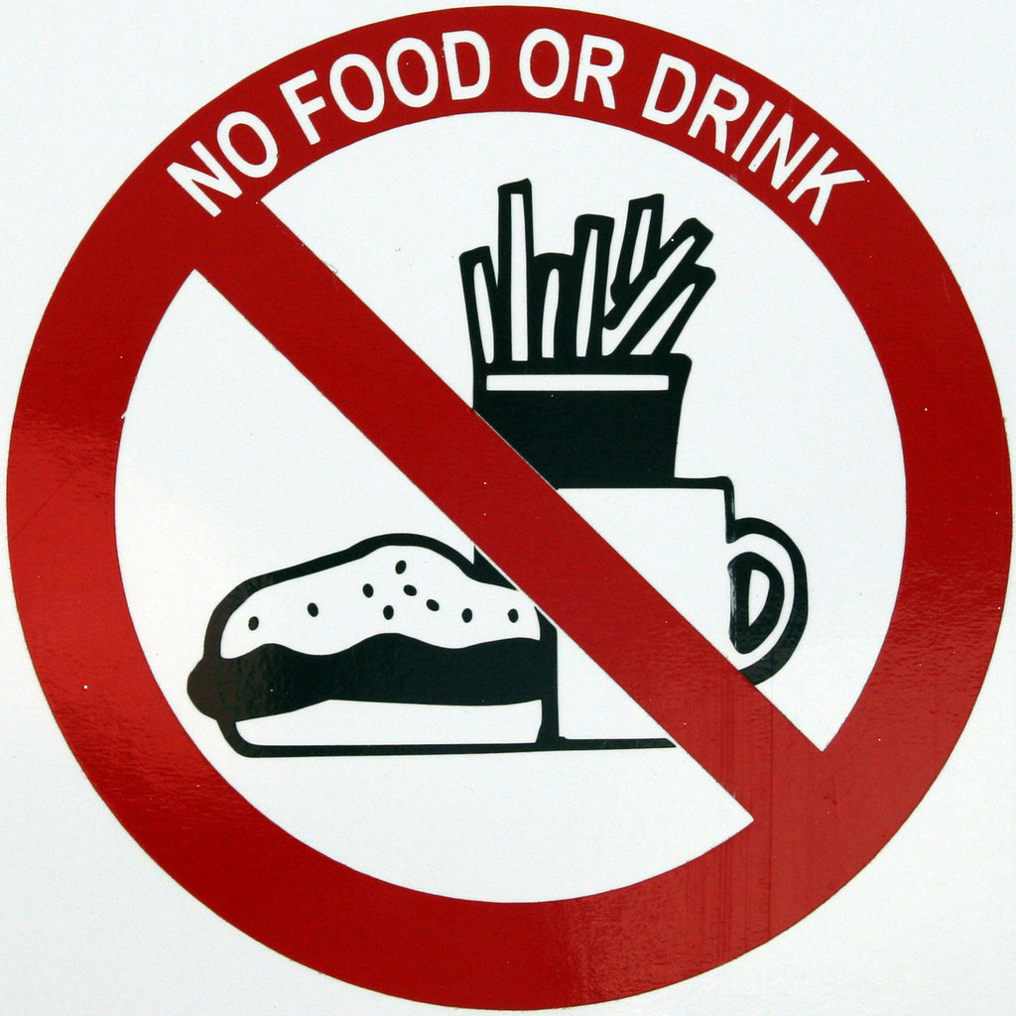
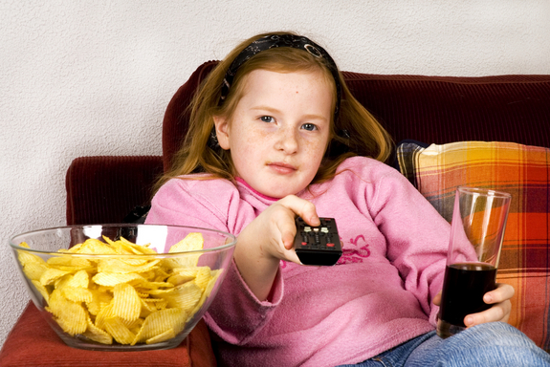
Finally “say no to junk food”
N n
This Photo by Unknown Author is licensed under CC BY-SA-NC

Slide 11
We all know that health is wealth if we want to live a healthy life then we need to adopt healthy eating habits.
……………………….

Slide 12
THANK YOU

